Slide 1
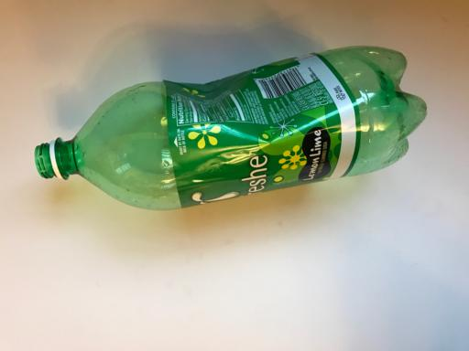
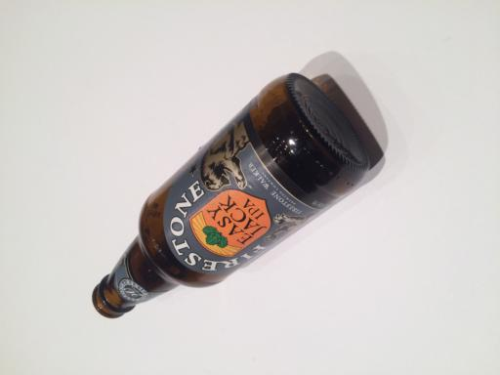
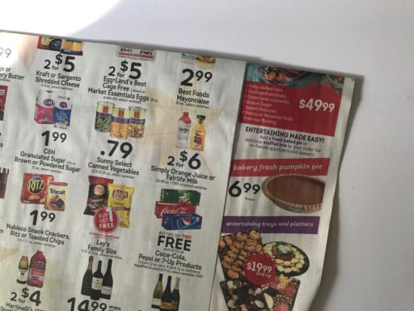
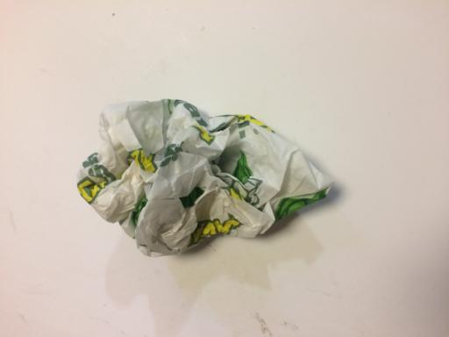
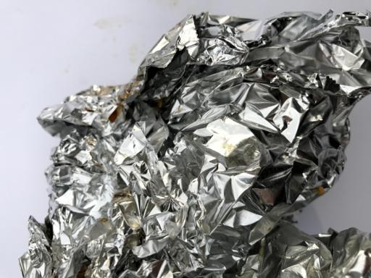
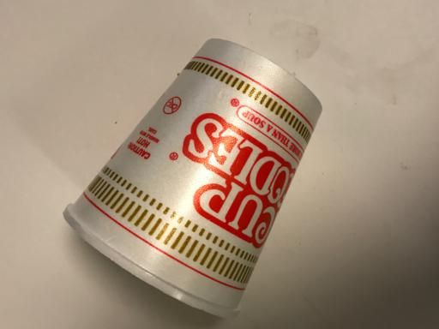
Garbage image classification
Help people to separate recyclable and non recyclable materials (App, recycling company)
Dataset: 2527 images (glass, cupboard, paper, plastic, metals, trash)
ML Image recognition

Slide 2
Additional Ideas
Extend dataset
  Garbage with disturbing background
  Mixed Garbage
Create app for users to suggest trash bin

